Slide 1
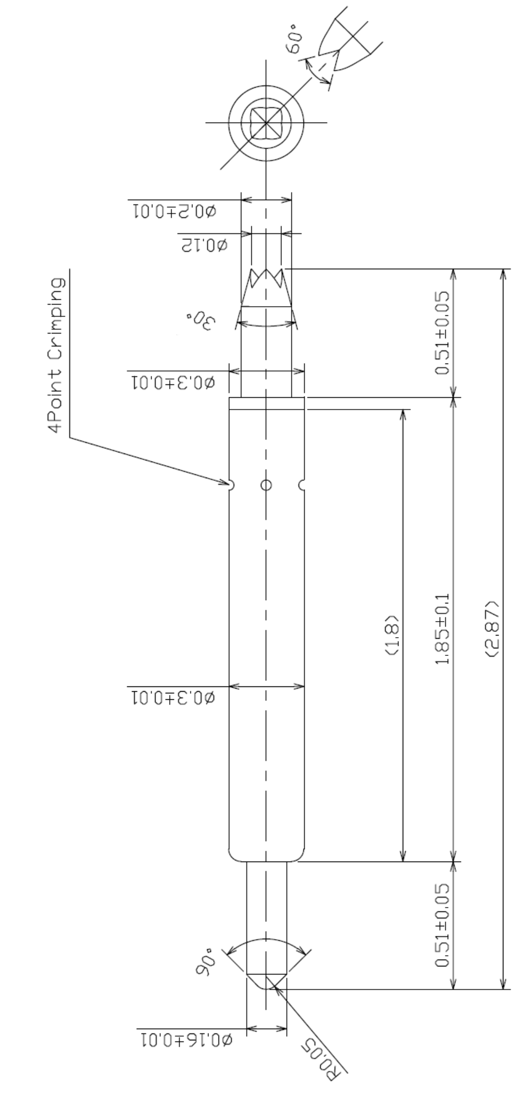
※ High speed POGO pin – 2.87mm / 0.4P
IVB-SAR-287-030-A237-00
Pitch | 0.4mm
Total Length | 2.87
Use Length | 2.57mm
Use Stroke | 0.3mm
Max Stroke | 0.4mm
Spring Force at Use Stroke | 16gf at 0.3mm Stroke
Operating Temperature | -40 to 200°C
DC Resistance | Avg. 45.0mΩ at 0.3mm stroke
Current Rating (Continuous) | 2.7A
Current Rating (Pulse 10%) | 3.0A
Capacitance | 0.56pF
Self Inductance | 0.53 nH
Bandwidth @ -1dB | 33.1 GHz
Insertion Life | 100,000 cycles

